Slide 1

Surface Hub 2S Whiteboard Guide

Slide 2
Table of contents
Whiteboard toolbar – Ink, Highlight, Erase, Ruler, Lasso, Insert, Undo, Redo
Work with images – Insert, Move, Resize, Cut, Copy, Stack
Whiteboard menu – Ink to Shape, Ink to Table, Background
Sign in to save and share – Sign in with Office 365
Export a whiteboard – Send Whiteboard as email attachment

Slide 3
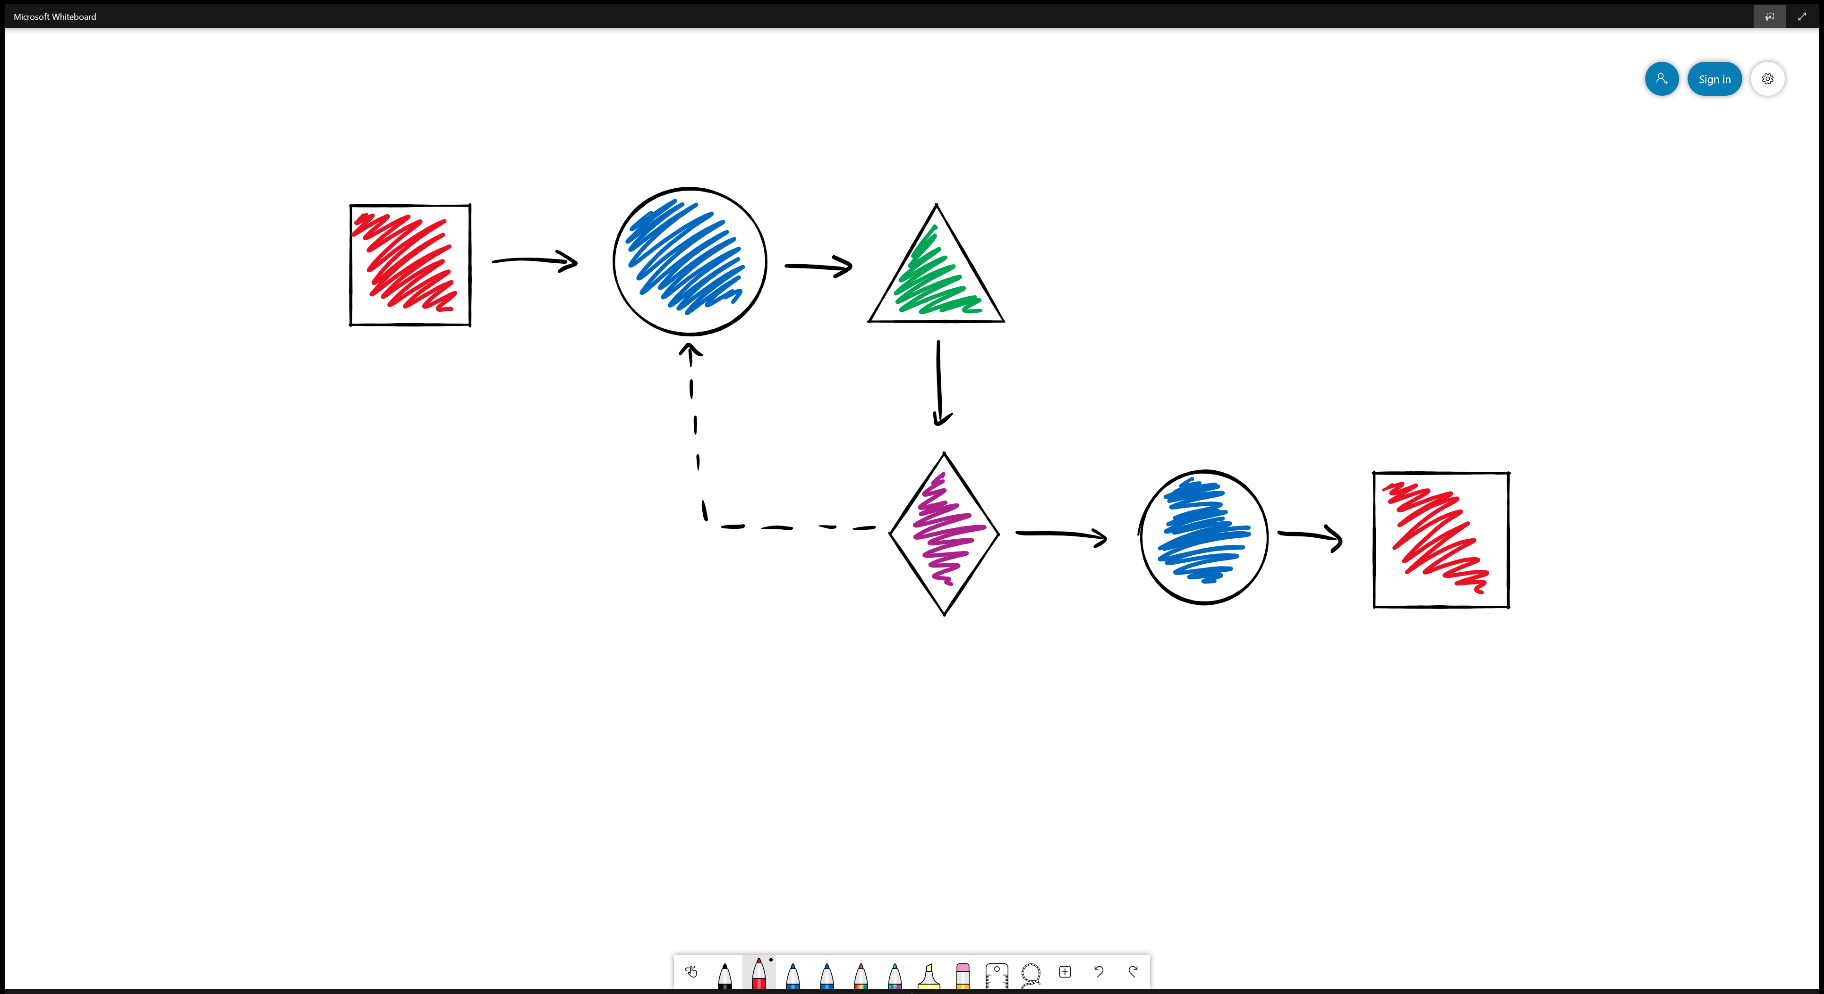

<- Back to Table of Contents

Slide 4










<- Back to Table of Contents

Slide 5
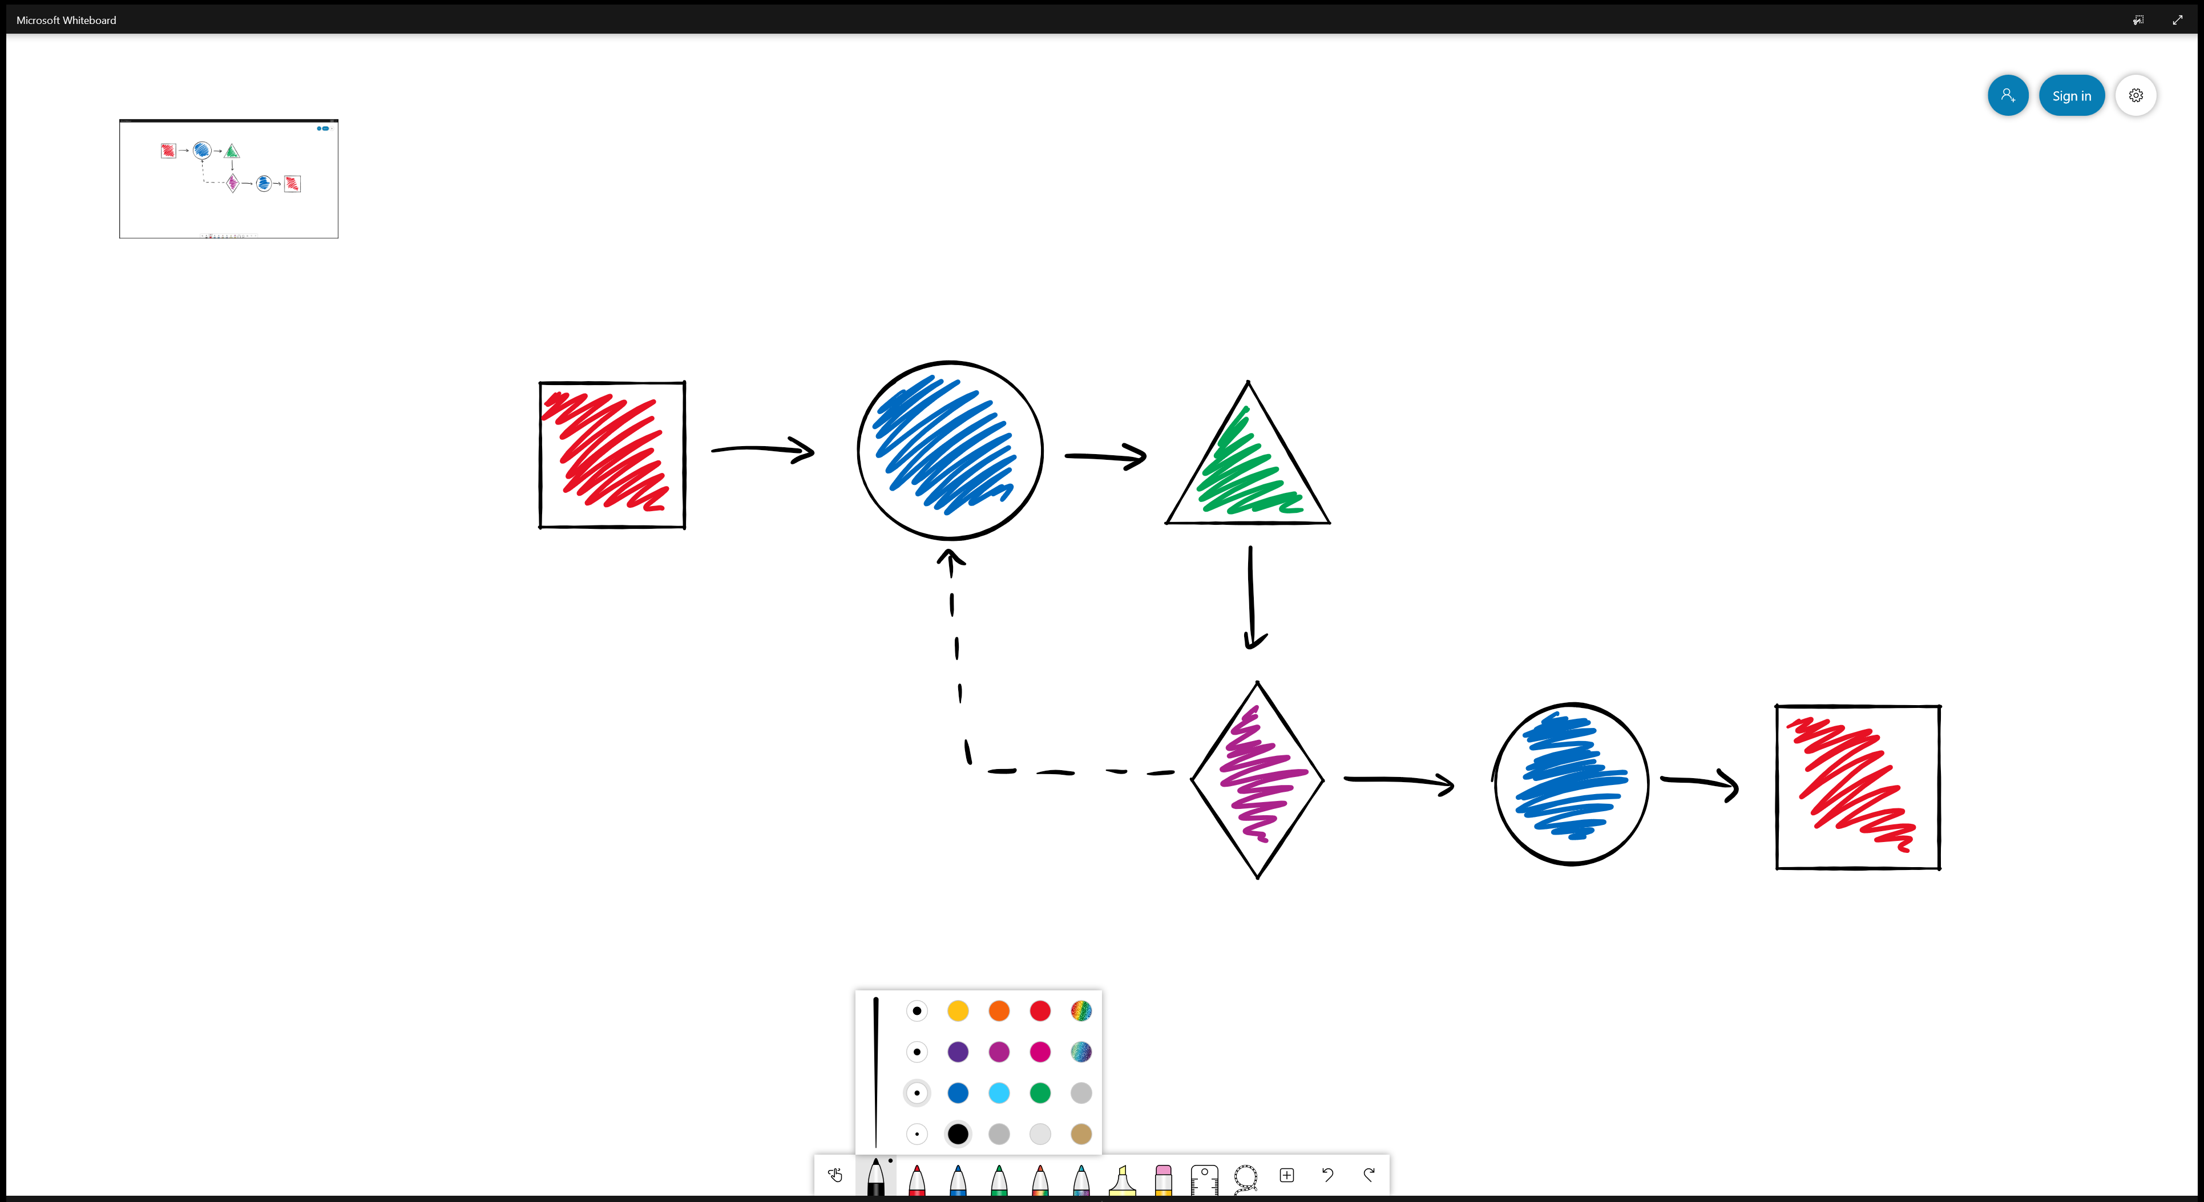

<- Back to Table of Contents

Slide 6

<- Back to Table of Contents

Slide 7
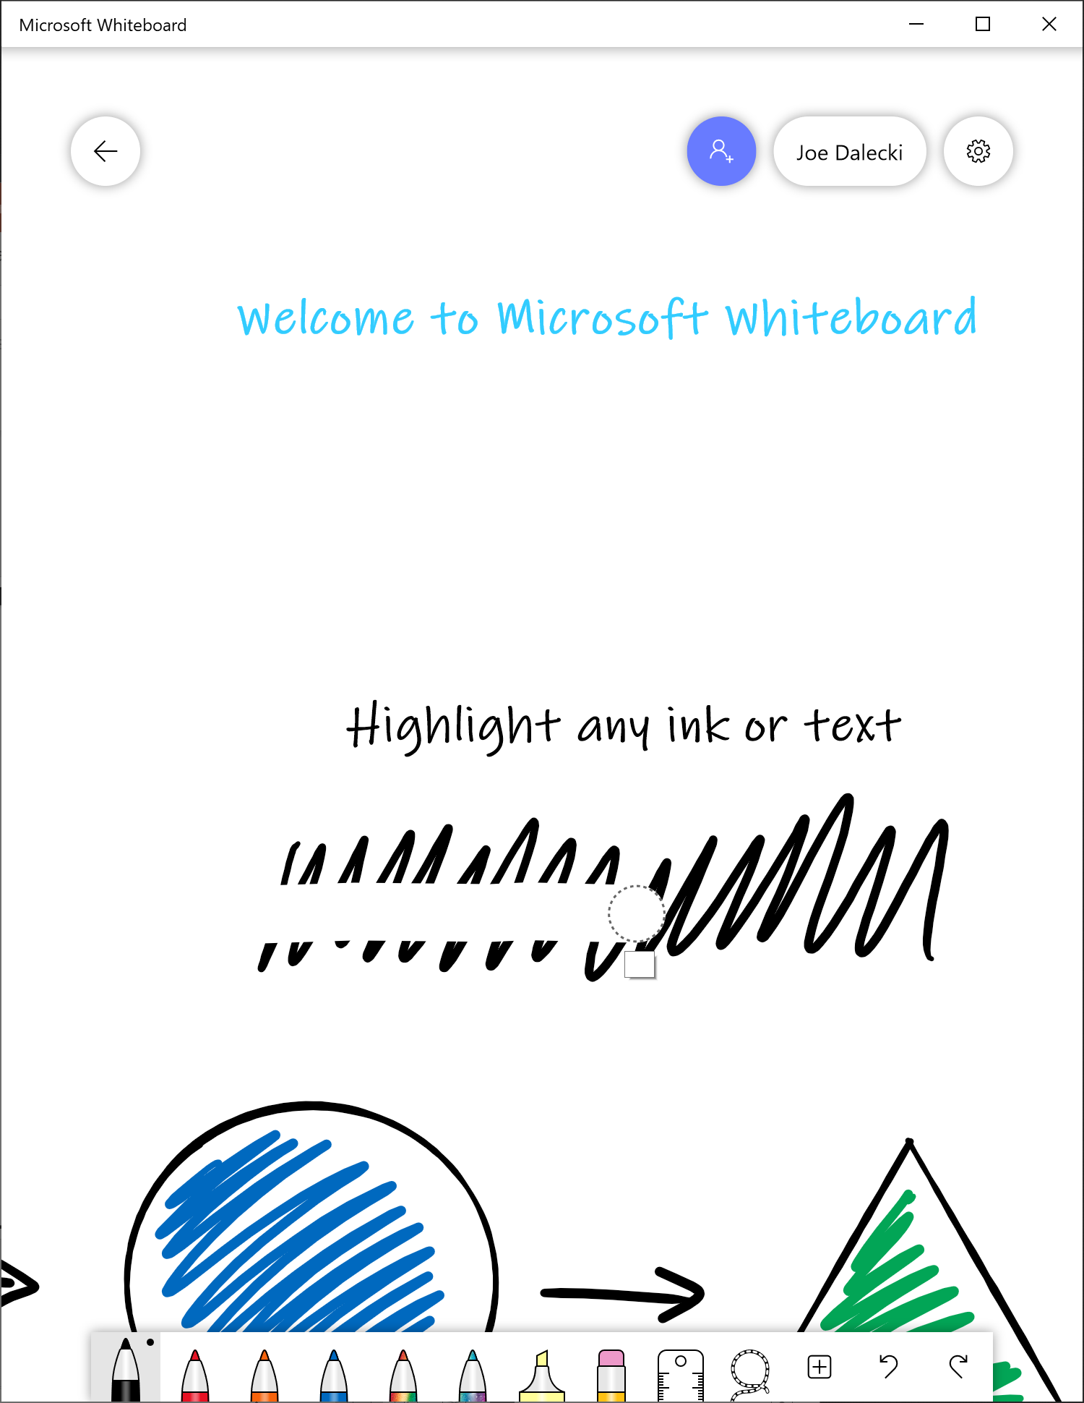

<- Back to Table of Contents

Slide 8
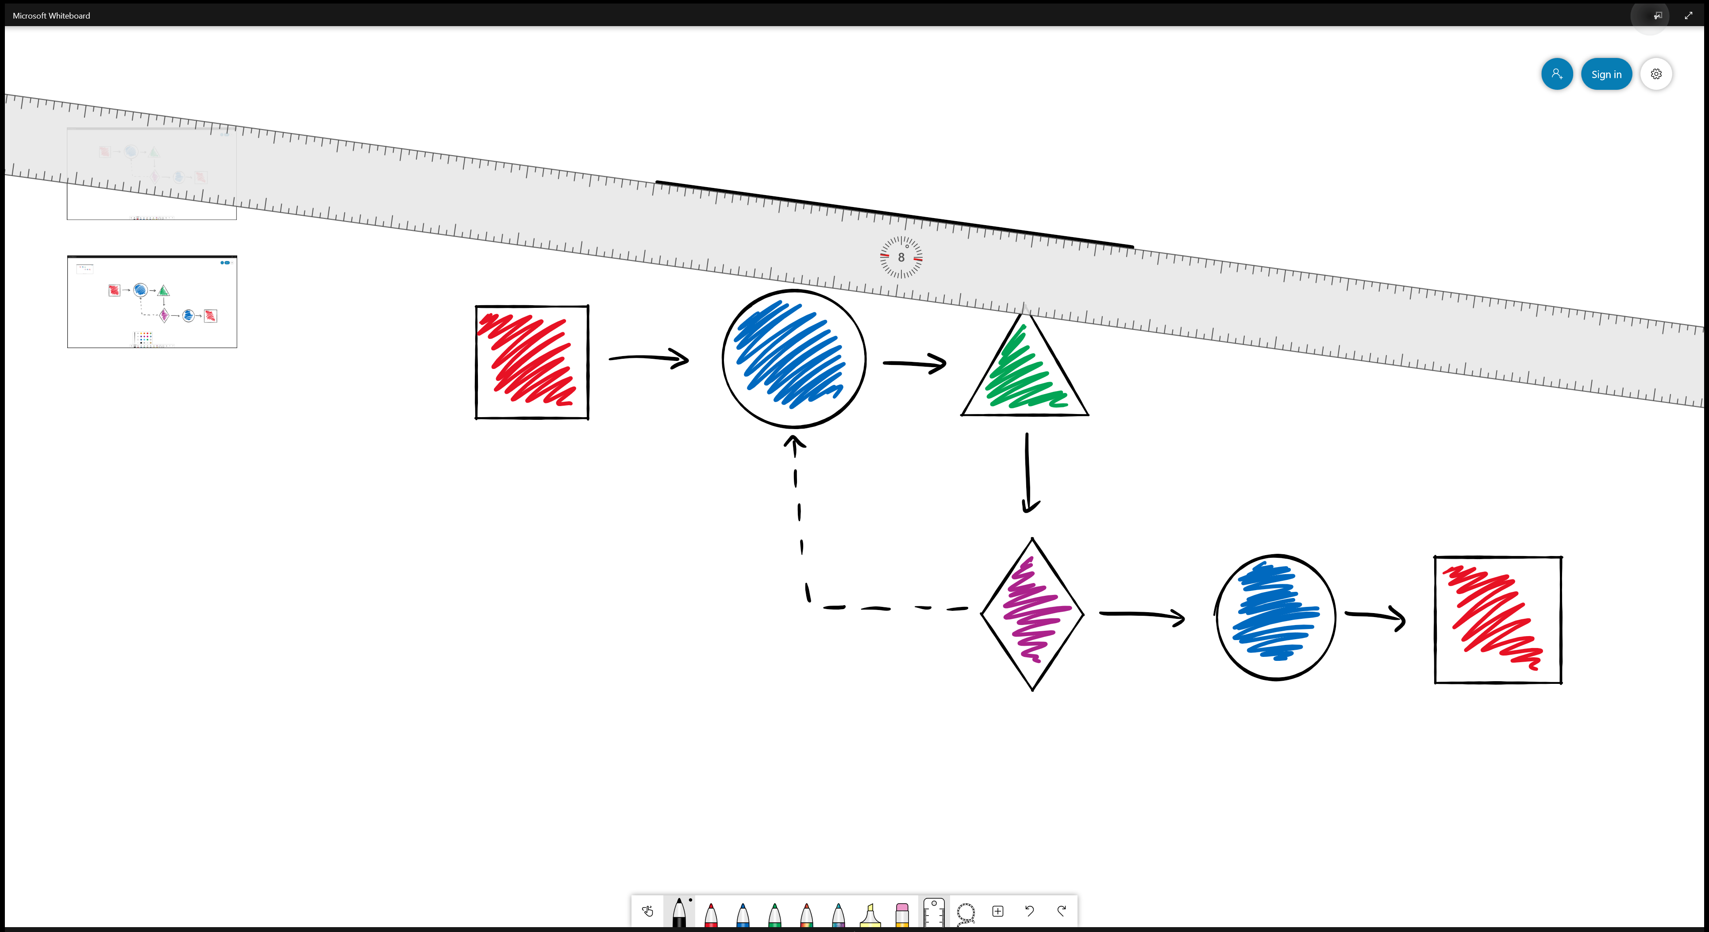




<- Back to Table of Contents

Slide 9
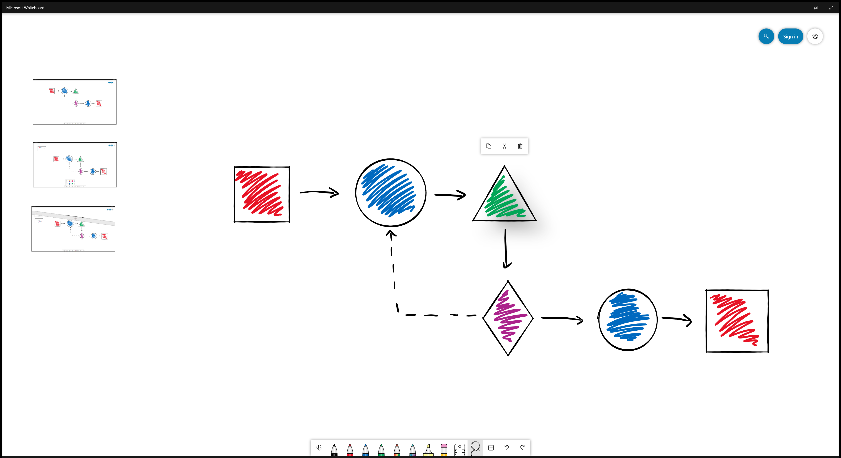



<- Back to Table of Contents

Slide 10
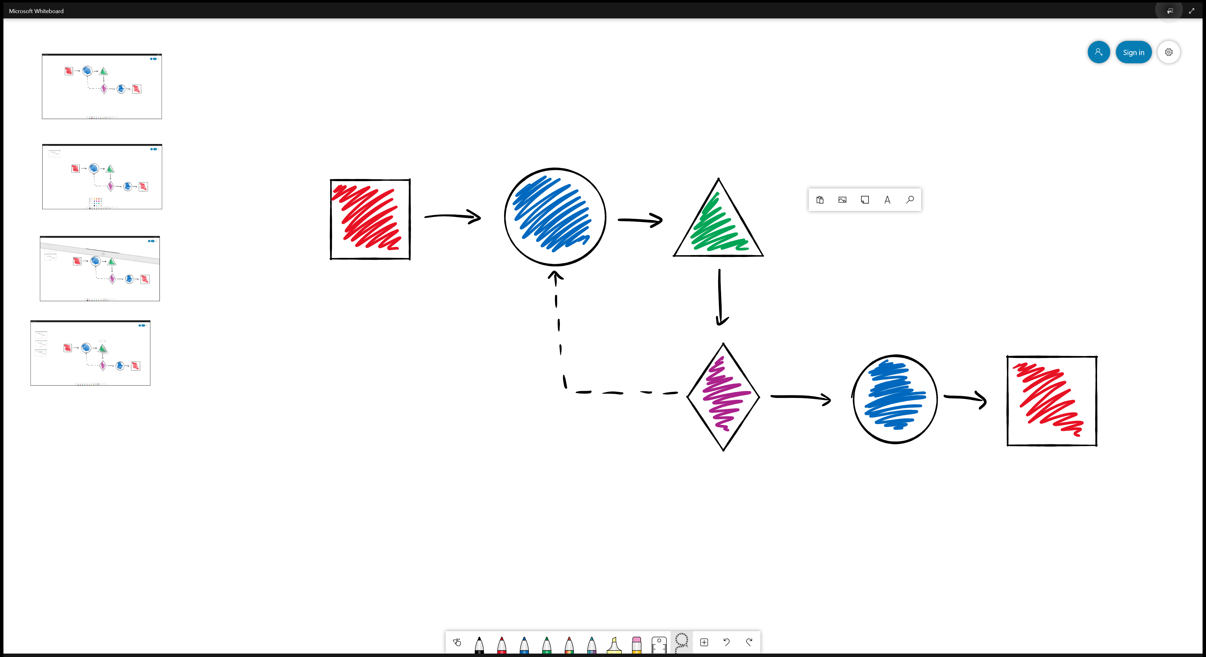

<- Back to Table of Contents

Slide 11
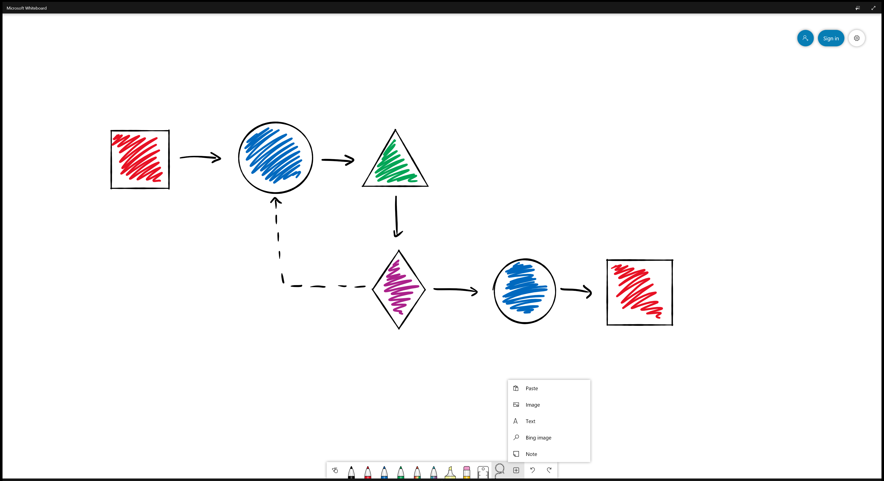


<- Back to Table of Contents

Slide 12
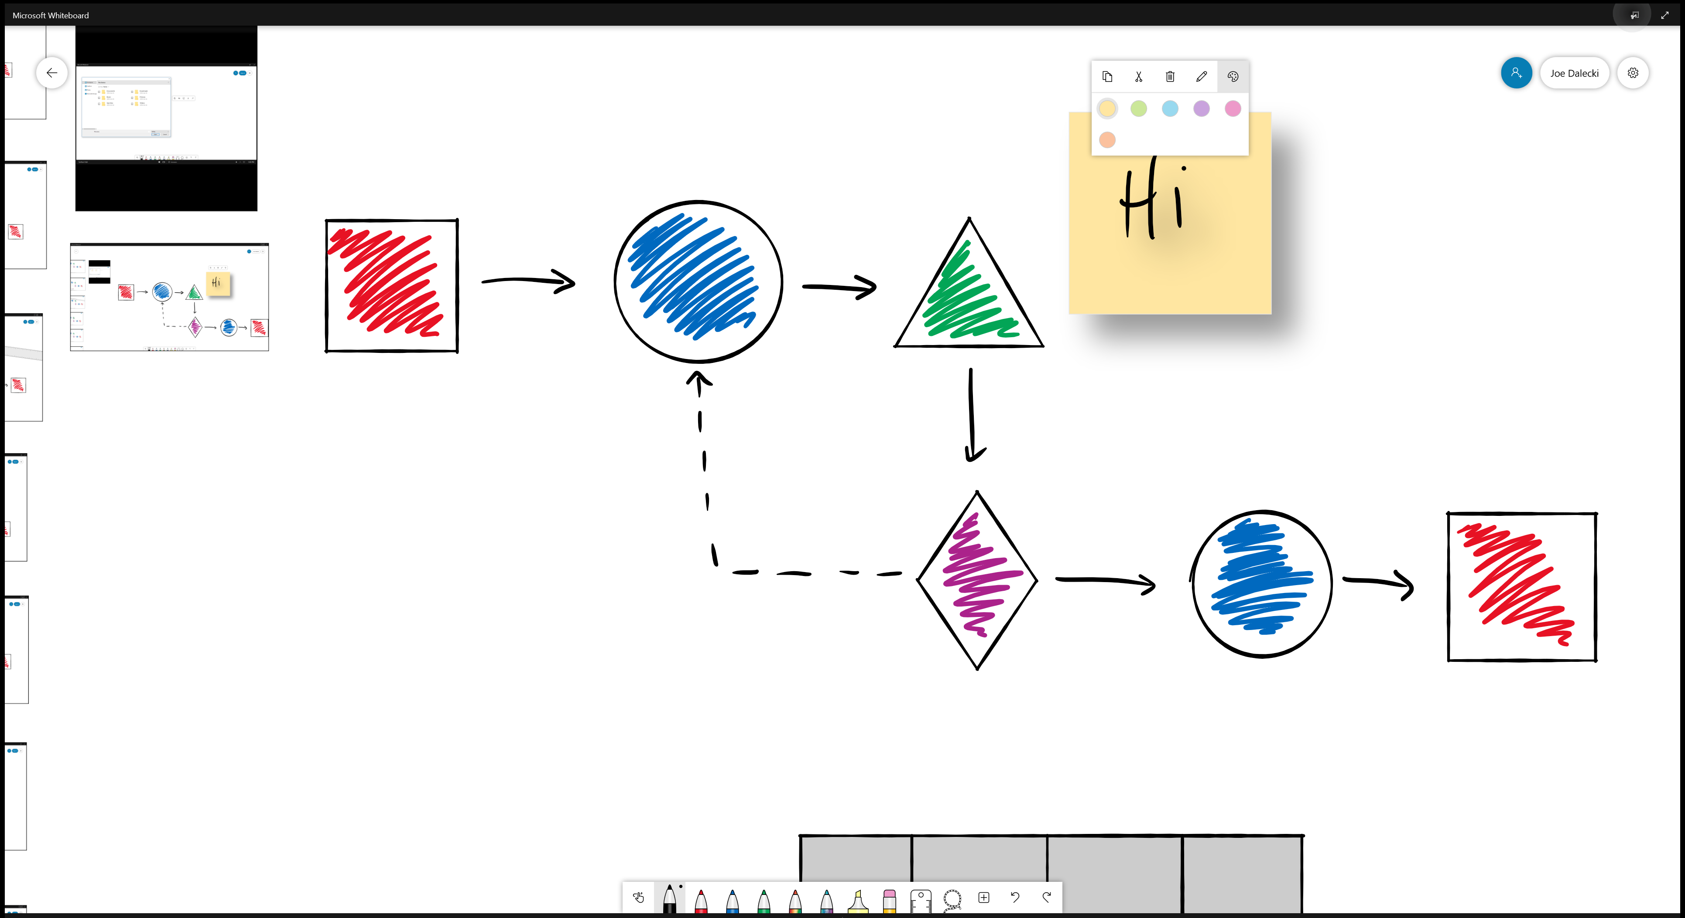

<- Back to Table of Contents

Slide 13
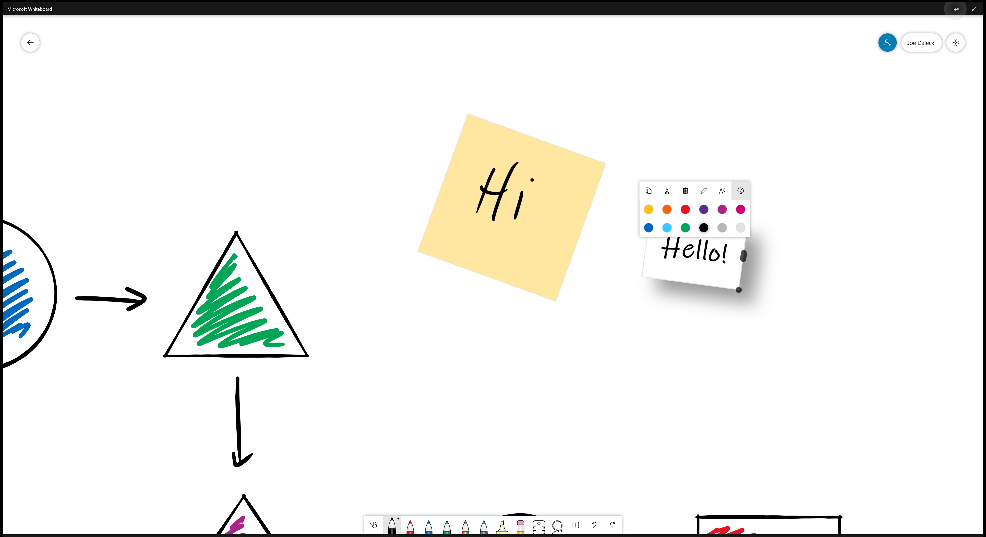

<- Back to Table of Contents

Slide 14

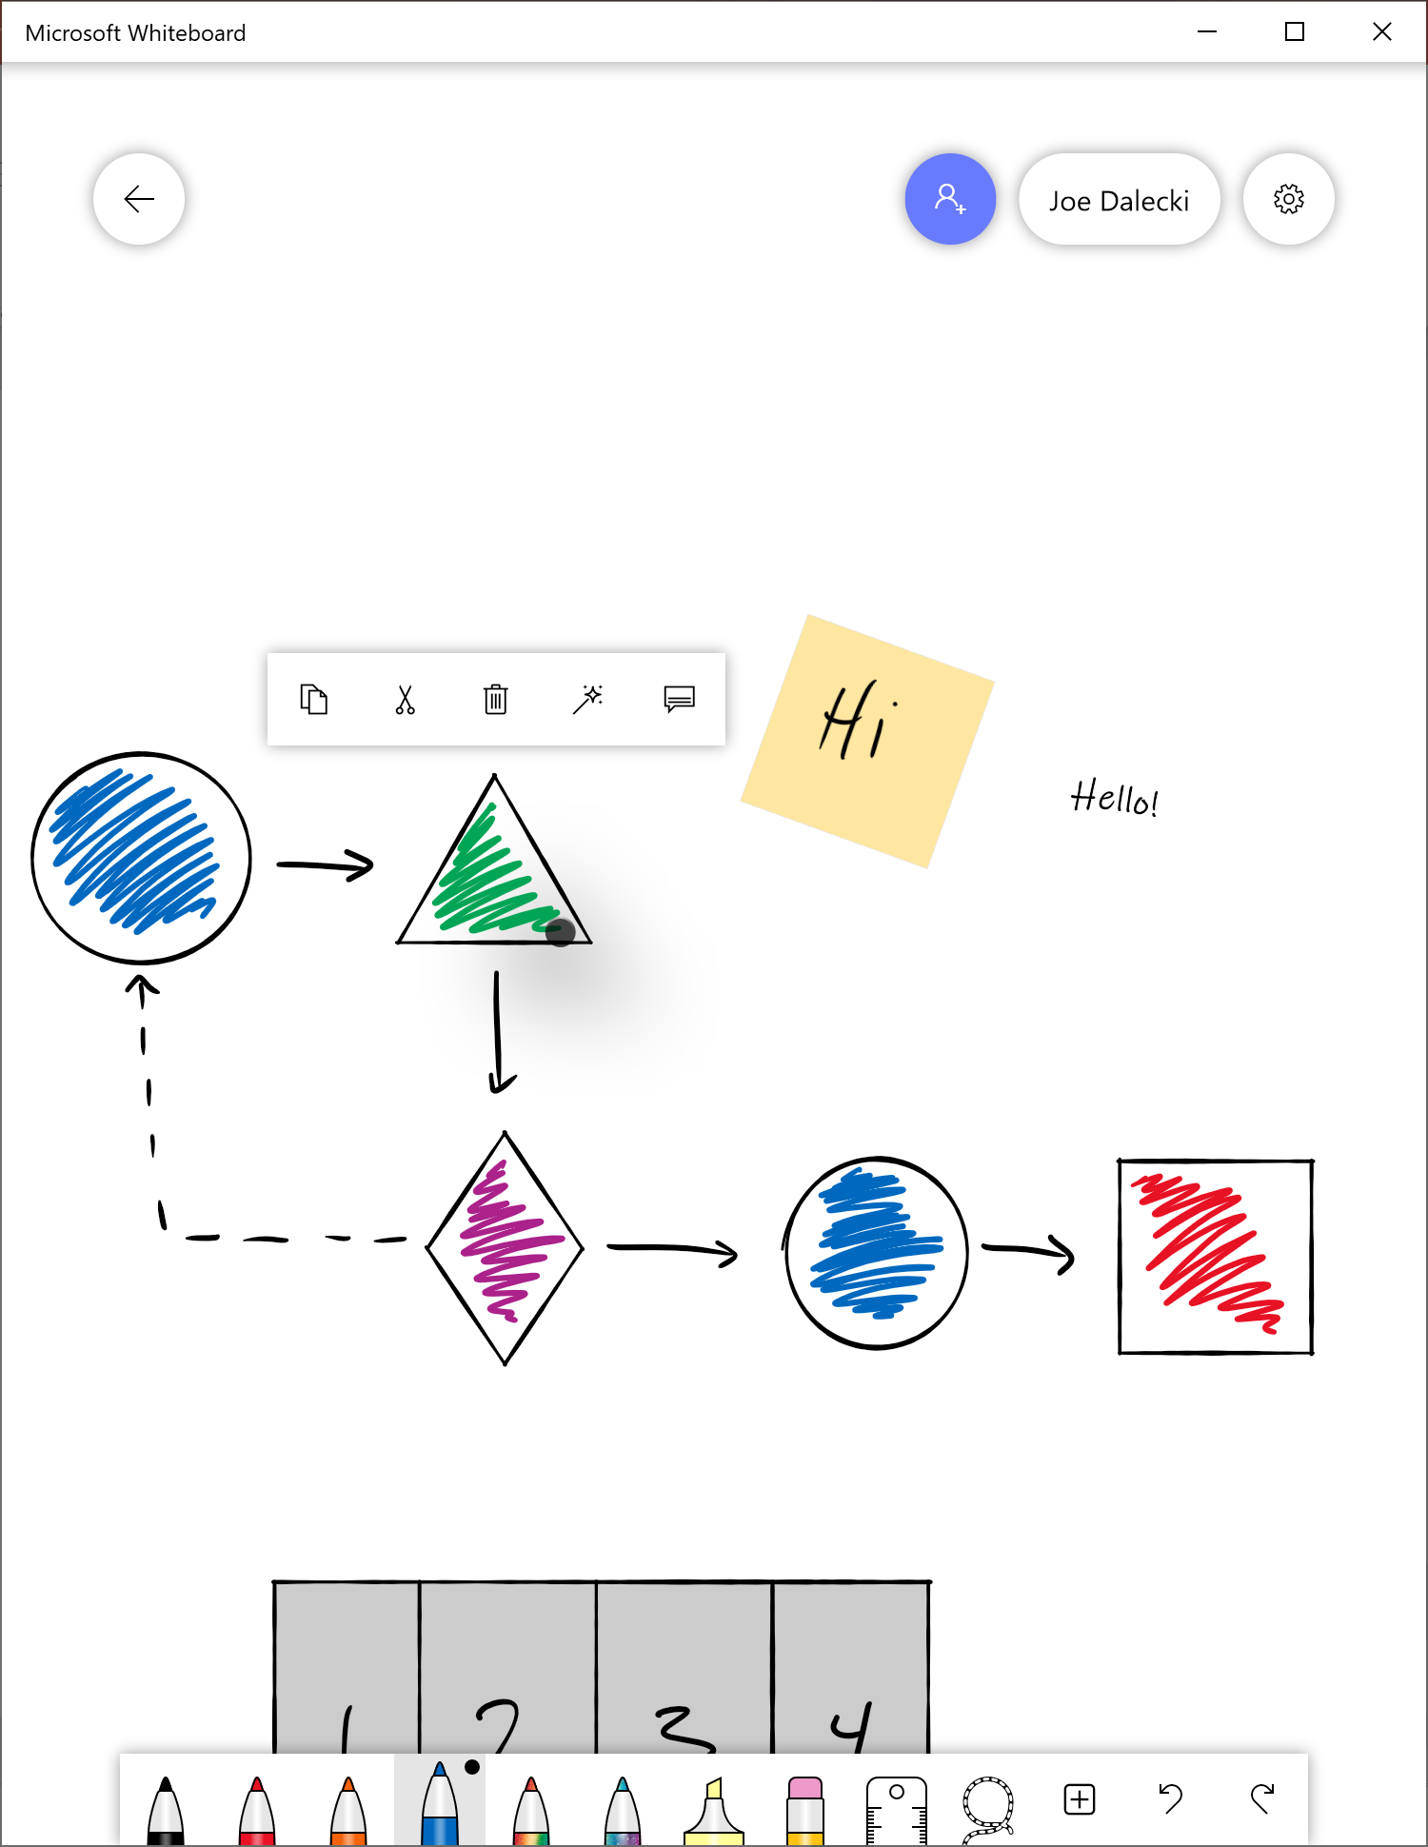

<- Back to Table of Contents

Slide 15
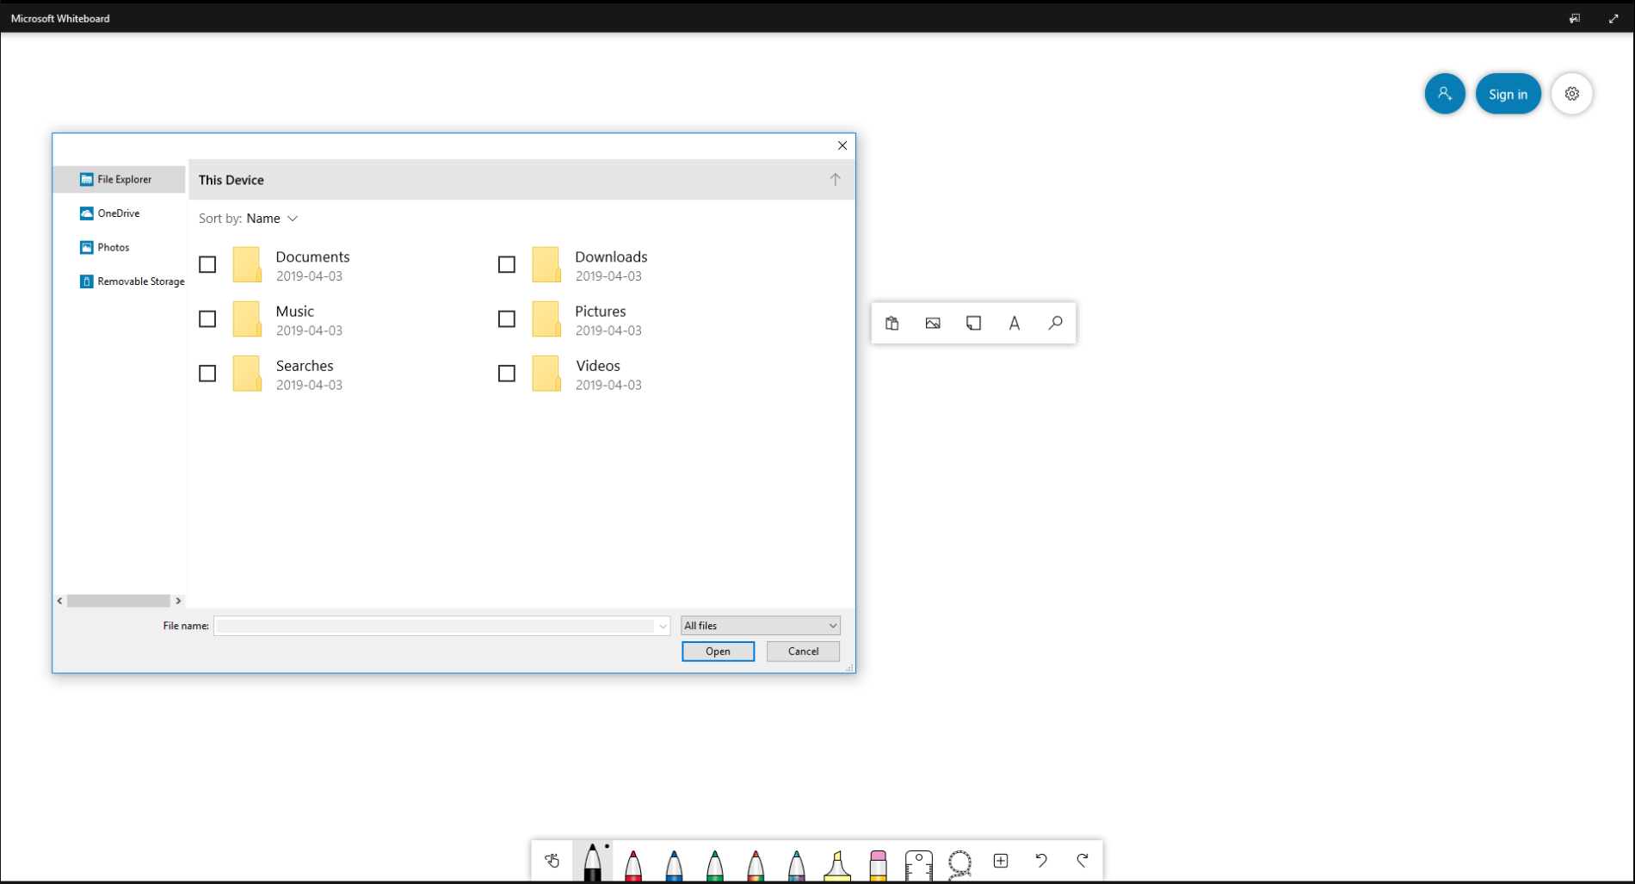


<- Back to Table of Contents

Slide 16

<- Back to Table of Contents

Slide 17
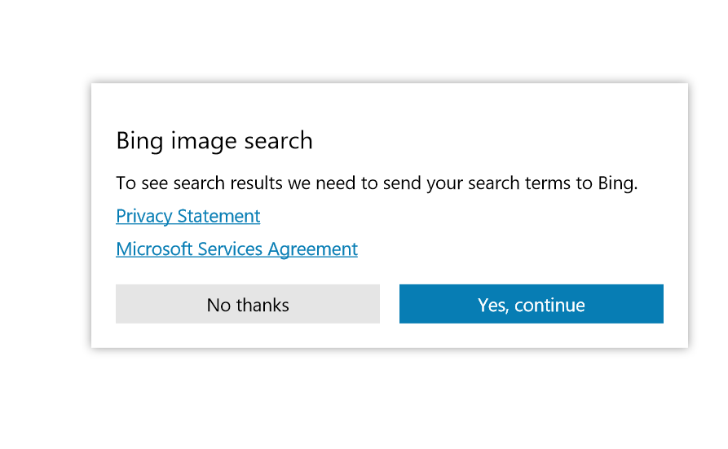




<- Back to Table of Contents

Slide 18


<- Back to Table of Contents

Slide 19




<- Back to Table of Contents

Slide 20
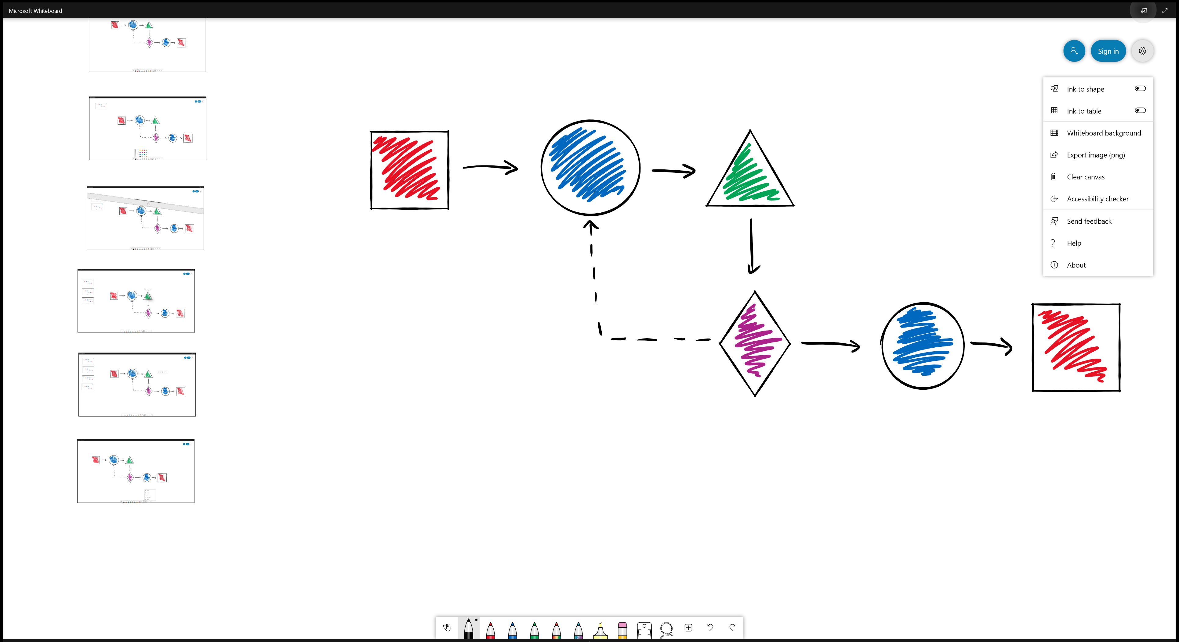

<- Back to Table of Contents

Slide 21

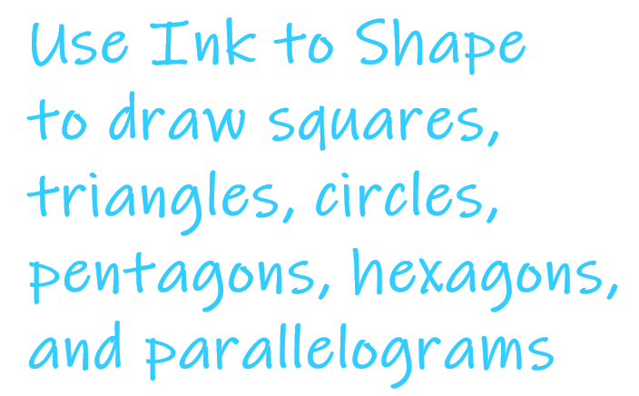
<- Back to Table of Contents

Slide 22
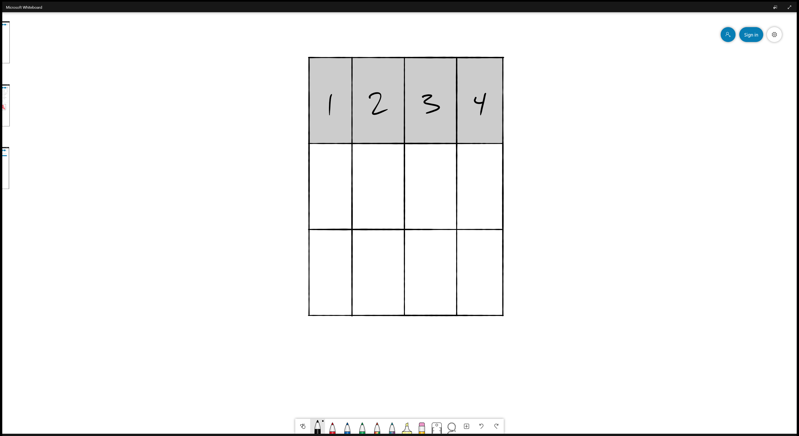
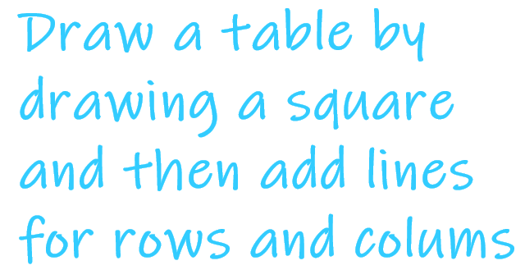
<- Back to Table of Contents

Slide 23

<- Back to Table of Contents

Slide 24
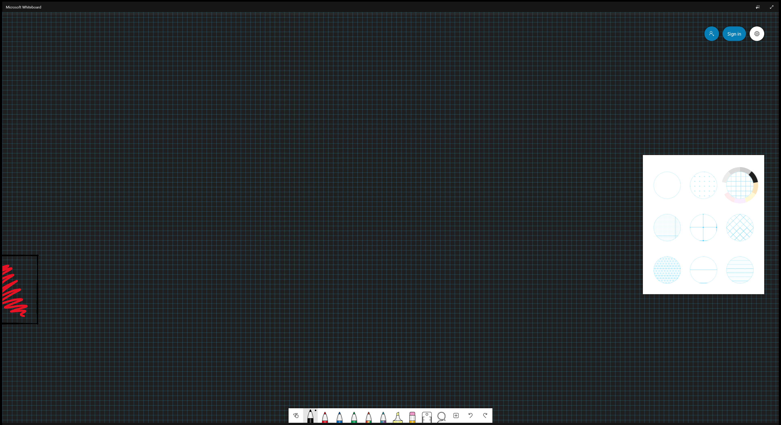

<- Back to Table of Contents

Slide 25
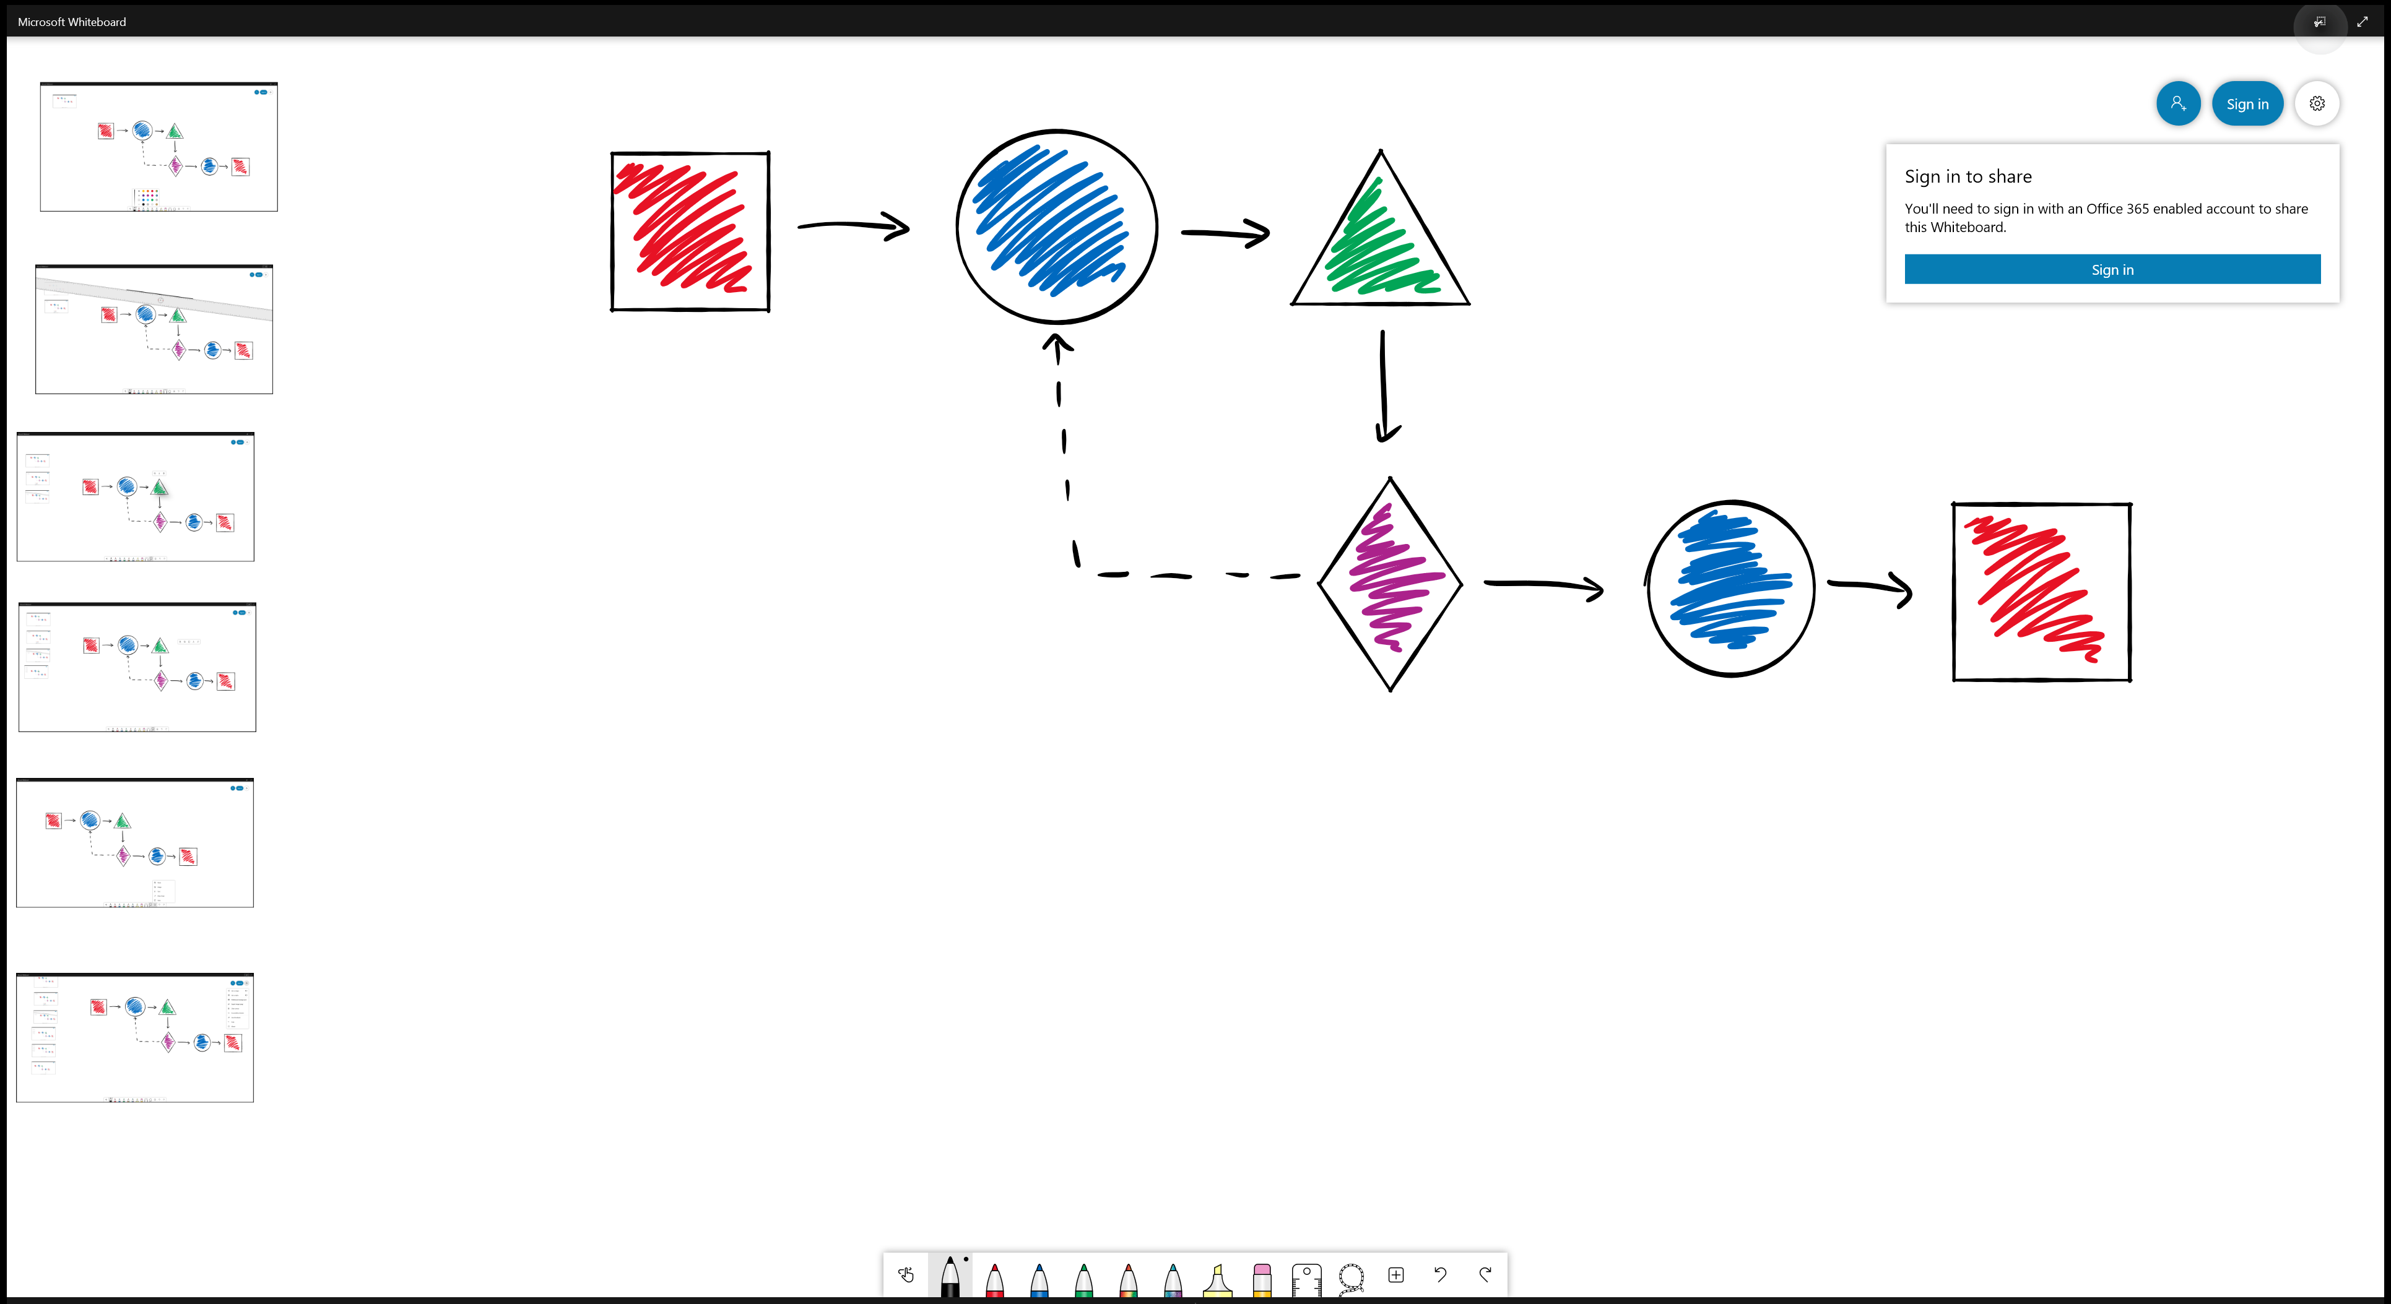

<- Back to Table of Contents

Slide 26

<- Back to Table of Contents

Slide 27
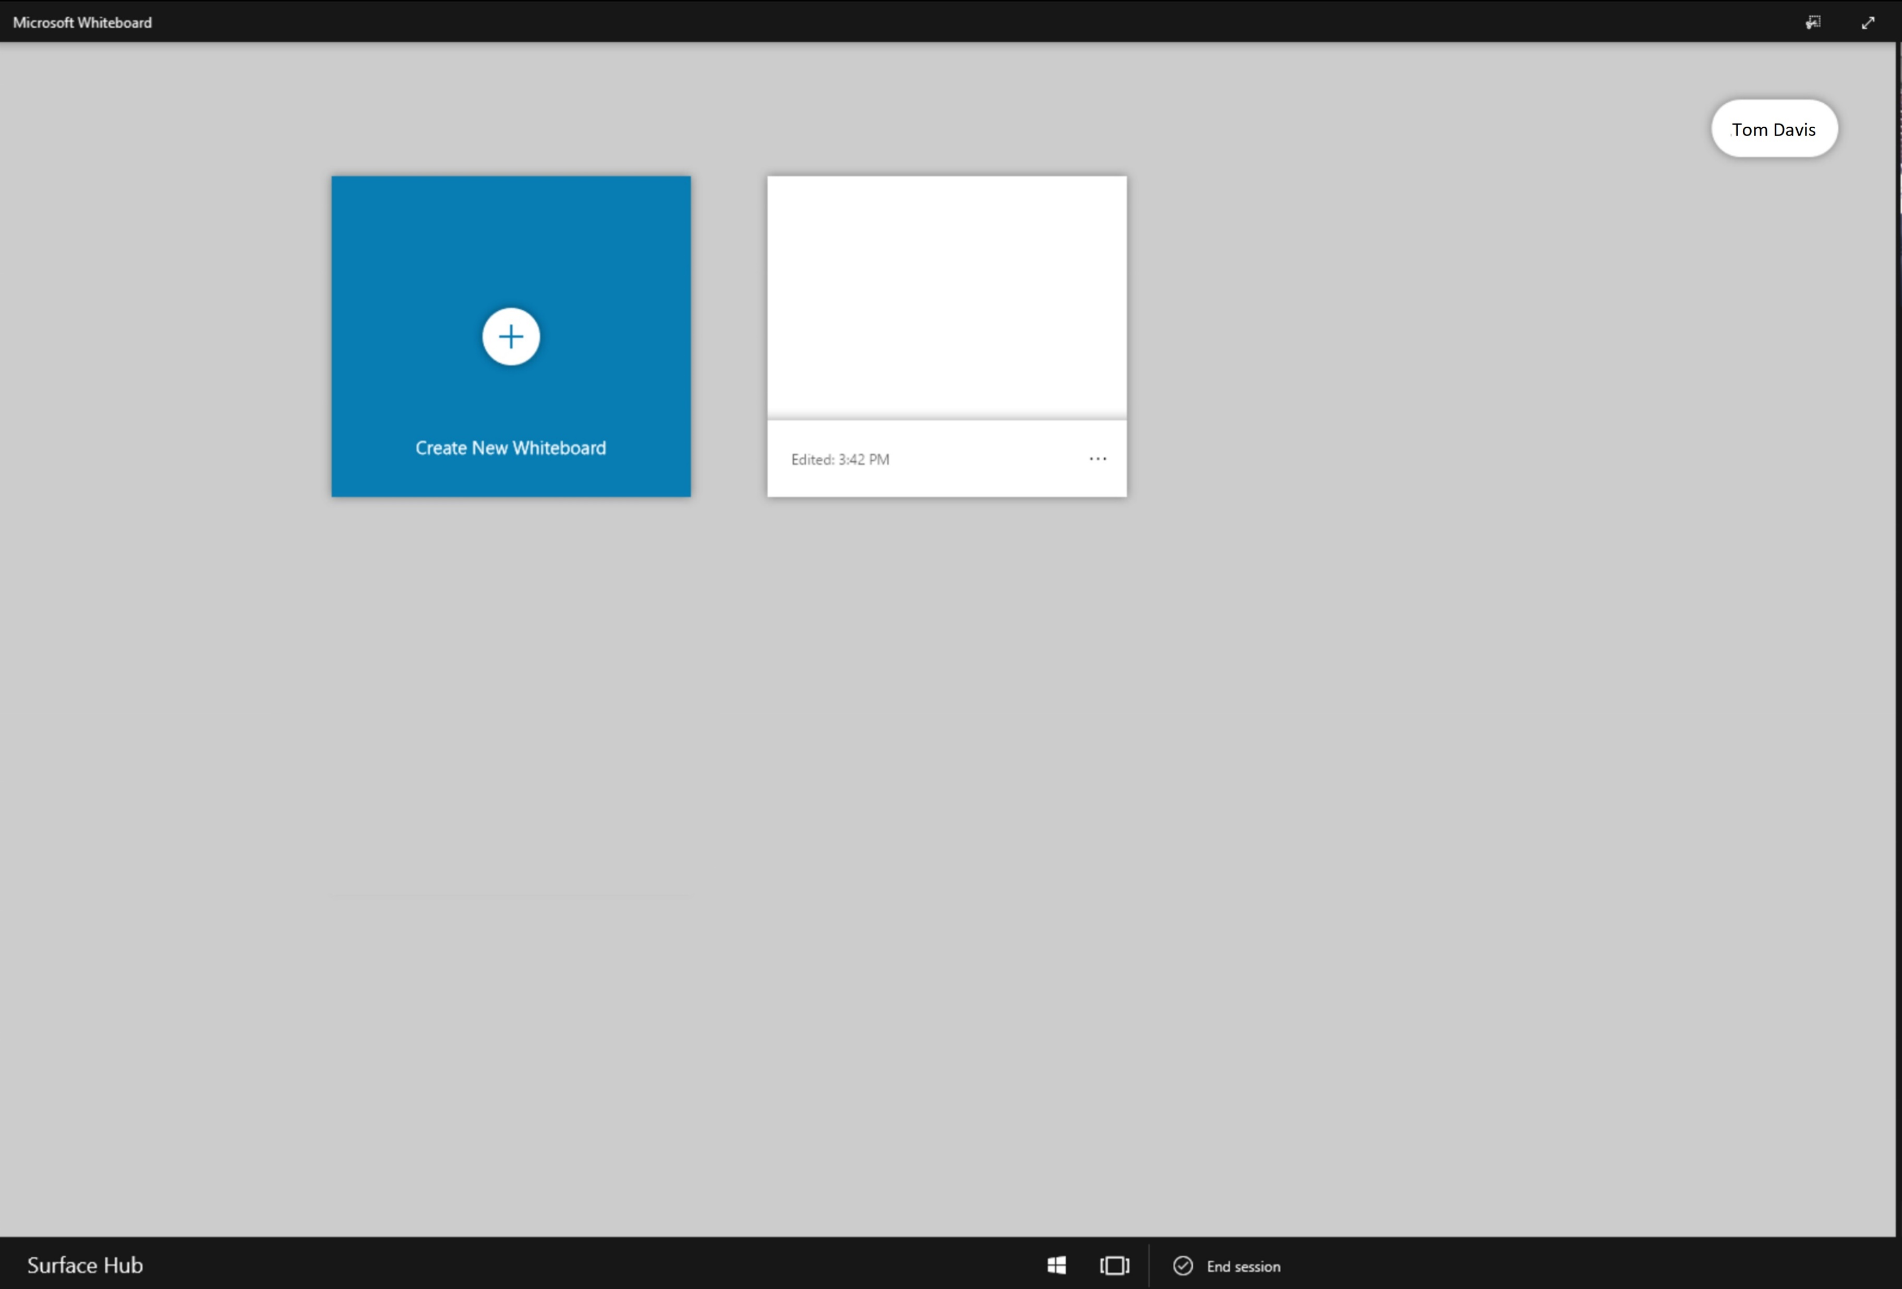



<- Back to Table of Contents

Slide 28


<- Back to Table of Contents

Slide 29
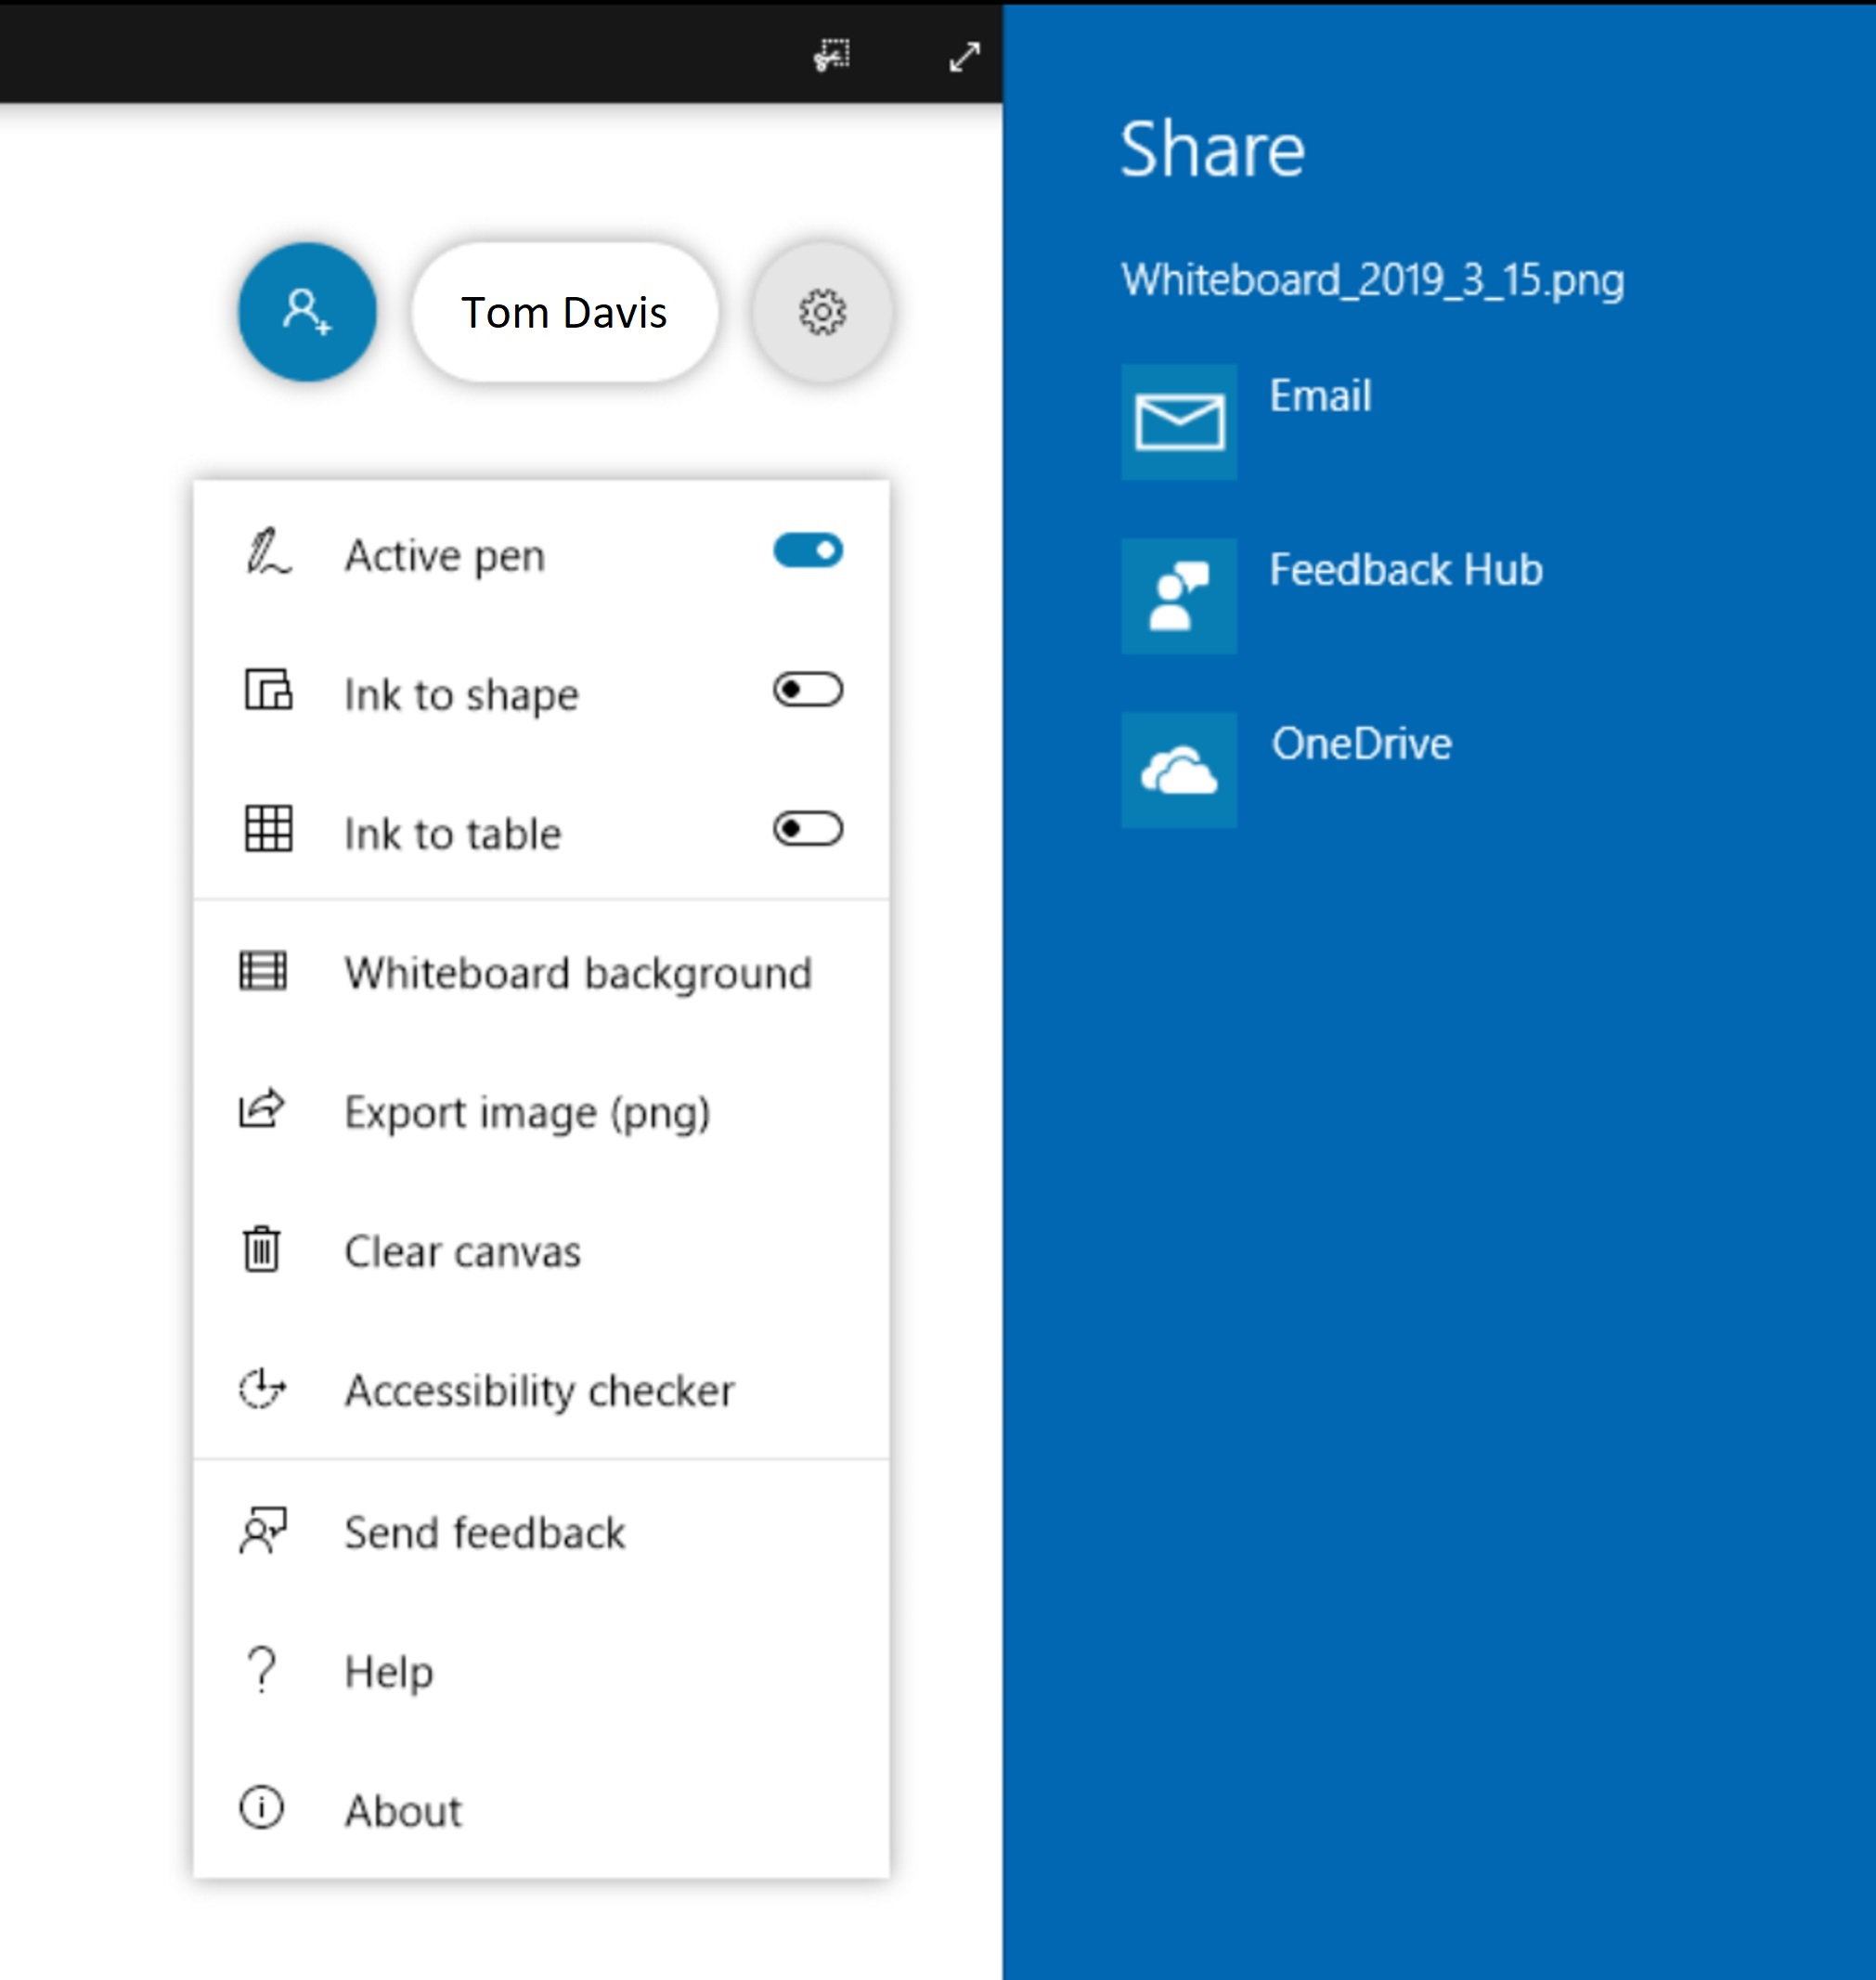


<- Back to Table of Contents

Slide 30

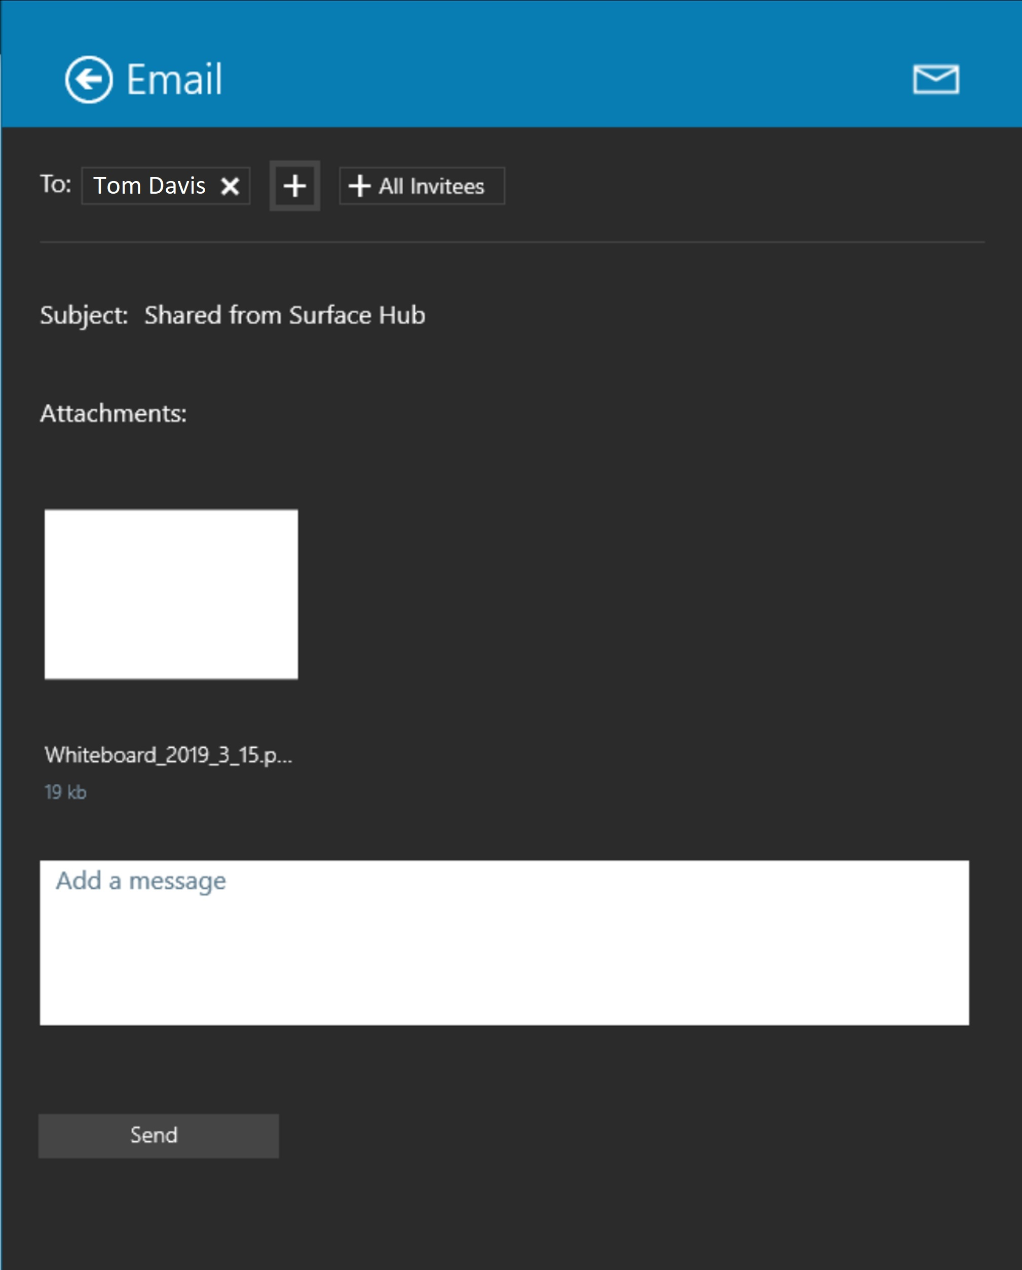







<- Back to Table of Contents

Slide 31

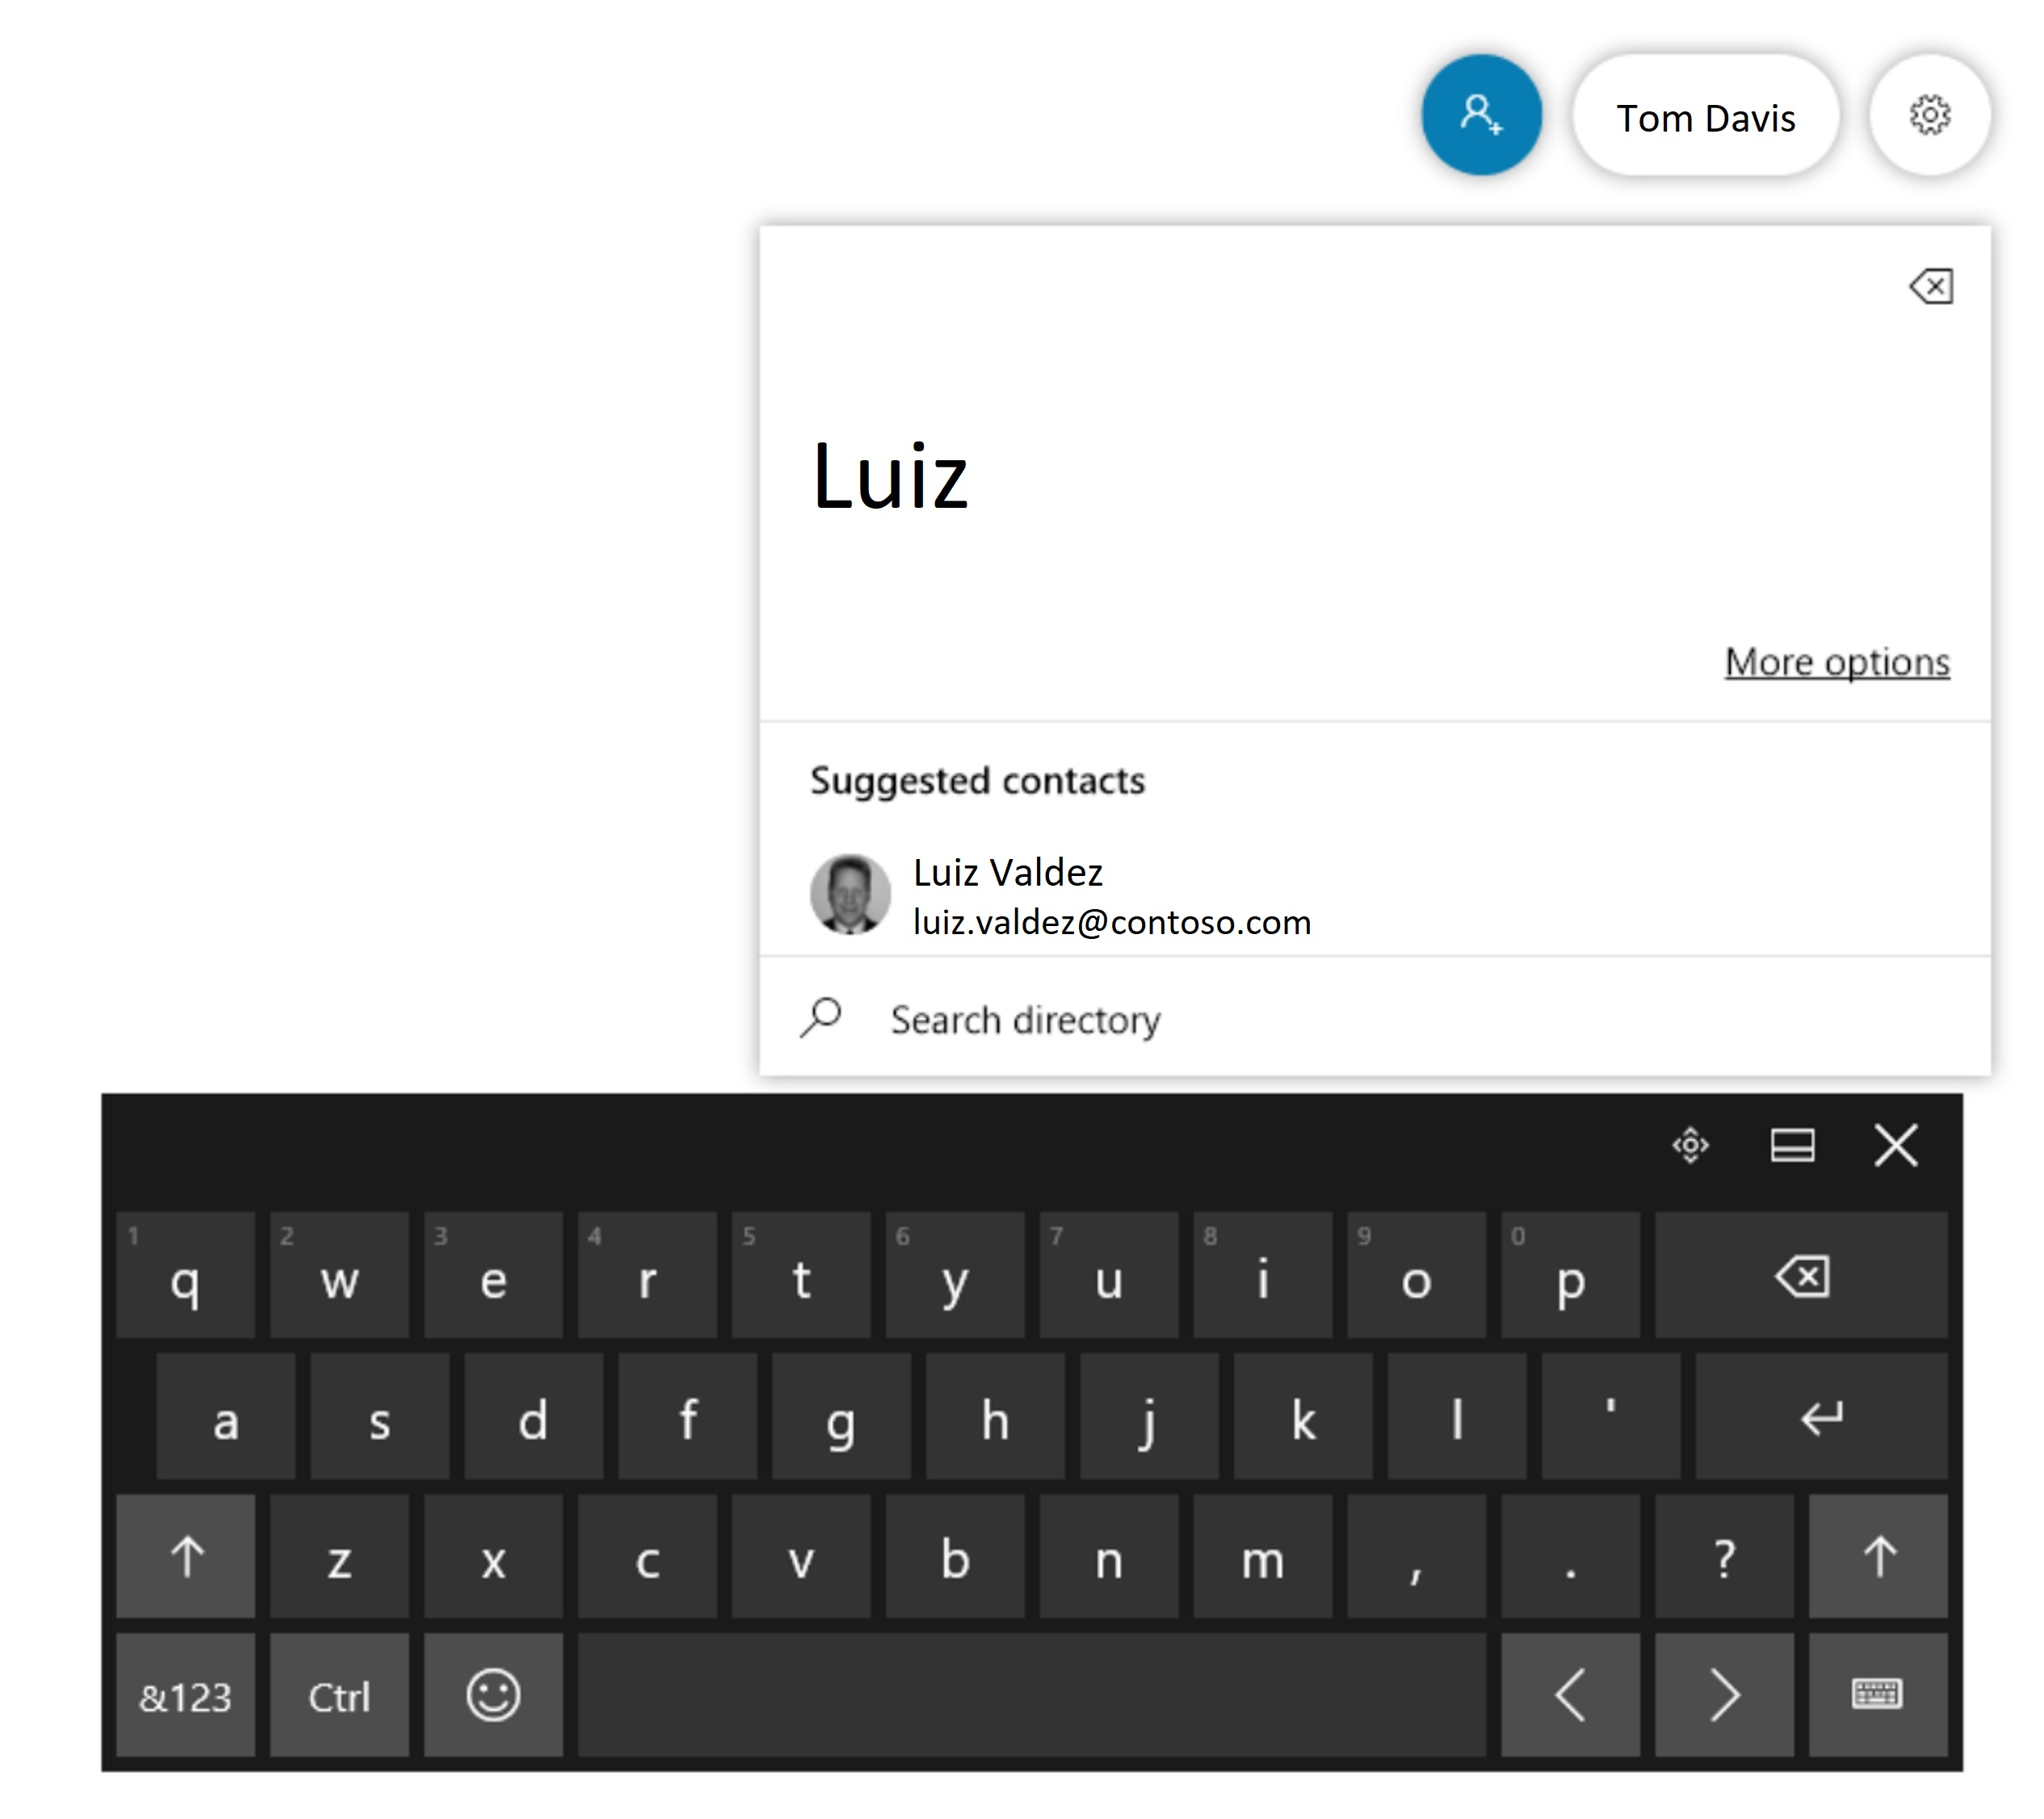


<- Back to Table of Contents

Slide 32
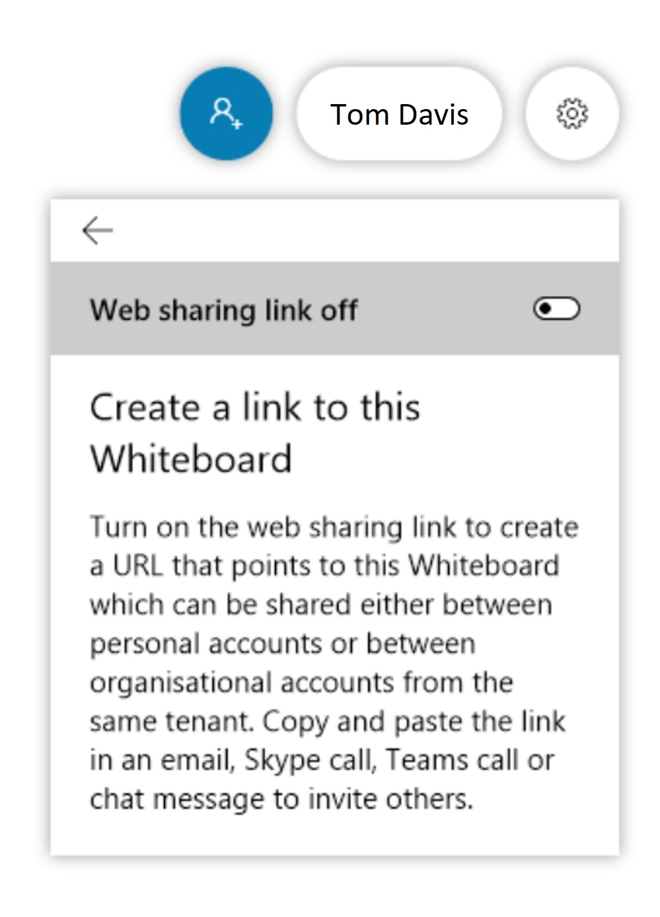



<- Back to Table of Contents

